Slide 1
RETAIL SHOP ANALYSIS - INSIGHTS PRESENTATION
Data-Driven Insights & Strategic Recommendations
Ganesh pareek

Slide 2
Project Overview
A comprehensive retail data analysis project utilizing MySQL for data querying and Power BI for interactive visualization, aimed at deriving actionable business insights from sales data.
Tools & Technologies Used
MySQL: Data extraction, transformation, and initial analysis
Power BI: Interactive dashboard creation and data visualization
Database: Retail sales dataset with transactions, products, regions, and customer segments

Slide 3
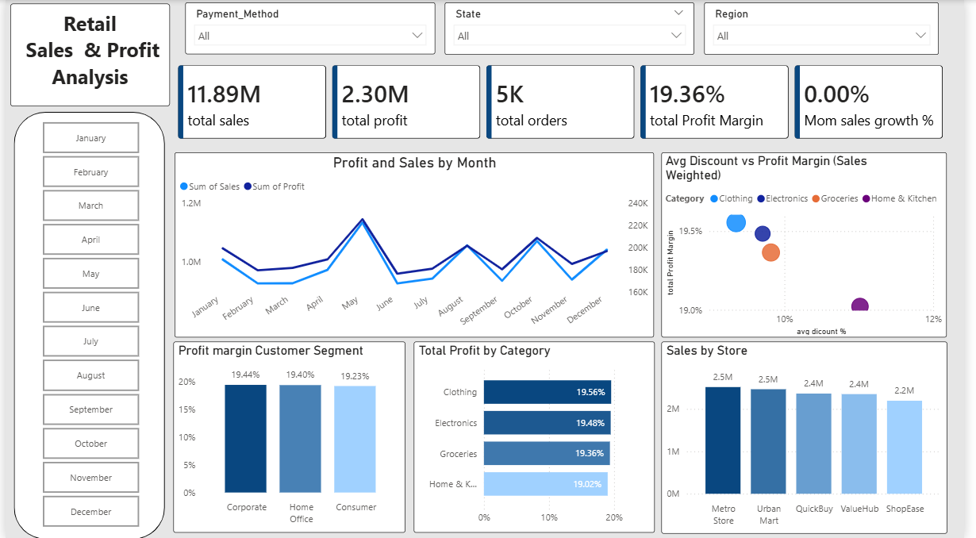
Power BI Dashboard
Click here to interact

Slide 4
Executive Summary
Key Highlights:
Total Sales: ₹11.89M
Total Profit: ₹2.30M
Total Quantity Sold : 24967 units
Most Profitable Category: Clothing
Top Performing Store: Metro Store
Preferred Payment Method: Bank transfer

Slide 5
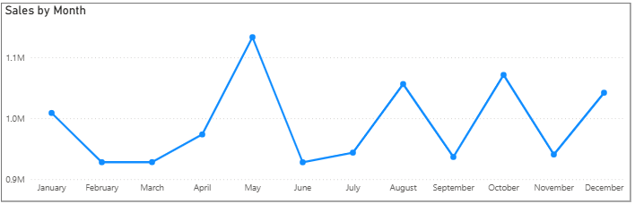
Monthly Sales Trend
Monthly Order Distribution:
Peak Months: May, October, August
Lowest Months: June, February, March
Insights:
Sales peak in May, with another strong rise in October and August, indicating mid-year and festive-season demand spikes.
The lowest performance appears around February, March, and June, showing early-year and post-peak slowdowns.

Slide 6
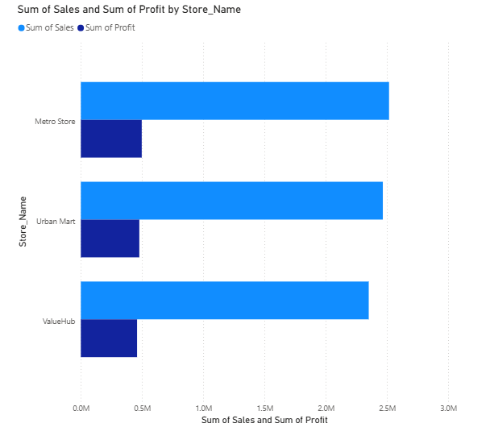
Store Performance Ranking
Top 3 Stores by Sales & Profit:
Metro store: ₹2.5M Sales | ₹497K Profit
Urban mart: ₹2.4M Sales | ₹477K Profit
valuehub: ₹2.3M Sales | ₹459K Profit
Insight: Metro store is the clear leader in
both metrics

Slide 7
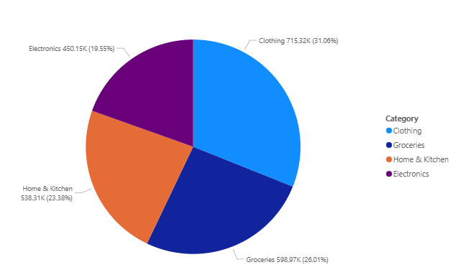
Category Performance
Profit by Category:
Clothing: ₹715K (31% of total profit)
Groceries: ₹598K (26% of total profit)
3.Home & kitchen: ₹538K (23% of total profit)
Insight: Clothing drives nearly half of
total profits

Slide 8
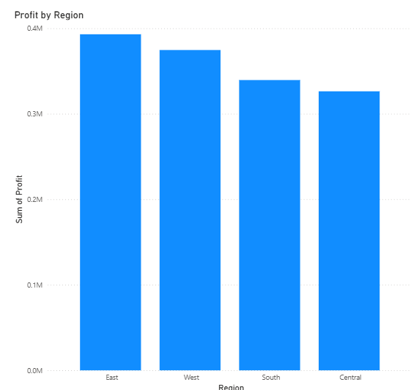
Regional Performance
Profit by Region:
East: ₹393K (Highest)
West: ₹374K
South: ₹339K
Central: ₹326K (Lowest)
Insight: East region outperforms others significantly

Slide 9
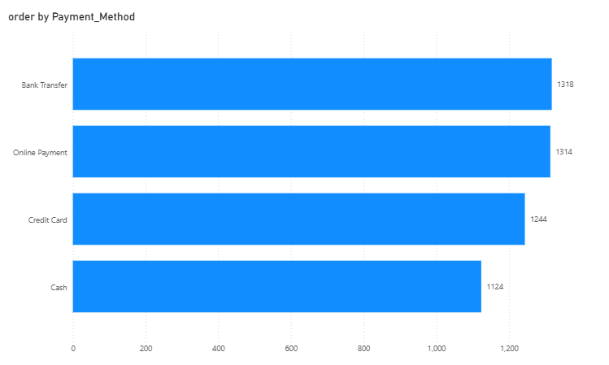
Payment Method Preferences
Customer Payment Preferences:
Bank transfer: 1318 customers (Most preferred)
Online payment: 1314 customers
Credit card: 1244 customers
Cash: 1124 customers
Insight: bank transfer and digital payments remains dominant despite cash

Slide 10
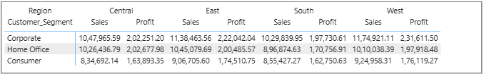
Customer Segment Performance by Region
Region | Best Segment (Sales) | Best Segment (Profit)
Central | Corporate (₹10M) | Home office (₹202K)
East | Corporate (₹11M) | Corporate (₹222K)
South | Corporate (₹10M) | Corporate (₹197K)
West | Corporate (₹11M) | Corporate (₹231K)
Insight: Corporate segment dominate, Home Office highly profitable in Central

Slide 11
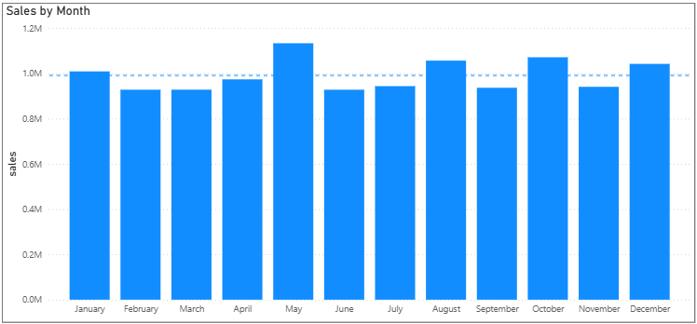
Monthly Sales Performance Classification
Sales Status by Month:
Above Average Months: January, May, August, October, December
Below Average Months: February, March, April, June, July, September, November
Insight: mid-year and early-year slowdowns compared to overall monthly performance.

Slide 12
Key Business Insights
Profit Drivers
  Clothing category & East region are profit powerhouses
  Metro store is leading profit generator
Underperformers
  Central region needs attention (lowest profit)
  Office supplies category is also needs attention
3.Customer Behavior
  Bank transfer is still king (most preferred)
  Corporate segment strong in East , South and west regions
4.Seasonal Patterns
  May-aug-oct months are peak season
  Feb-mar-jun needs revival strategies

Slide 13
Recommendations
Short-term Actions:
Reduce discounts 5% on low-margin items
Bundle loss-making sub-category (snacks, phones) with high-profit sub-category
Promote Bank cash payments with small incentives
Regional Strategy:
Investigate Central region underperformance
Replicate East region success factors in other regions
Target Corporate segment in East and South more aggressively

Slide 14
Product Strategy:
Stock more products from men and women sub-category (top profit generators)
Review pricing for products from snacks and phones sub-category
Leverage corporate category growth across all regions
Promotional Calendar:
Increase marketing spend in feb-mar-jun to boost slow months
Plan major campaigns for may-oct-aug peak

